Slide 1
Planning an App

Slide 2
Concept
1
You probably already have one

Slide 3
What makes a good breakable toy idea?
Personal interest or passion
"Layers" - so you can start small and build up
Showcases your skills

Slide 4
Common Answers
It's OK if your idea exists!
Don't try to "sell" your app!
The purpose of your Breakable Toy is to demonstrate the skills you've learned
Notes:
These two weeks are about building an app that you can add to your portfolio to showcase the technical skills you've learned! If you built Google or Facebook in 2 weeks, are potential employers more likely to say:
A) "That's lame, the world does not need another Google"
B) "Whoa, this student learned all this stuff and built Google from scratch in 2 weeks!" Along the same lines, you don't need real users for your app and you're not pitching Shark Tank. You're showcasing your skills in a short amount of time, so focus is key.

Slide 5
Questions to think about
What's a cool single feature widget I wish existed?
What's a question I'd like to answer with API data?
What's a fun game I'd like to recreate online? (Careful with this, many games are suuuper complex to model, data-wise!)
What is a problem somebody in my life has that could be solved with simple software?

Slide 6
Core Requirements
Database-backed Rails app
Multiple models with CRUD for each
At least one component in React
Ideas for "fancy" features (e.g., external APIs, data visualization, cool JS or React features?)

Slide 7
Workflow
2
How Rome was *actually* built

Slide 8
Core Requirements
Idea
Prioritized Feature Concepts ("the List")
Core ER Diagram / Models
User Stories and Acceptance Criteria
TDD off into the sunset!

Slide 9
Features: "dream list" vs. "do it now list"
Dream List
All those cool ideas and features that I've been dreaming about if I had infinite time...
Do It Now List
Simplest, most core features that involve 1 or 2 models so you can get started!
Manage complexity by starting small, and taking small steps!
Notes:
It's always great to have an idea of where you're going. But maintainable apps are not built monolithically - they're built one small piece at a time.

Slide 10
Features: "dream list" vs. "do it now list"
Dream List
Facebook, Twitter, Yelp, MySpace, Napster, and GitHub integrations
Do It Now List
Facebook, Twitter, Yelp, MySpace, Napster, and GitHub integrations
...Because it's easiest to integrate
Notes:
It's always great to have an idea of where you're going. But maintainable apps are not built monolithically - they're built one small piece at a time.
Or sometimes you want to integrate authentication from Facebook, Twitter, Yelp, MySpace, and Github. Start with just one. Probably Github because it's easier.

Slide 11
Breakable Toy #2 Assignment
Core ER Diagram
"Ideal" ER Diagram
Initial User Stories and Acceptance Criteria
Brief Description ("Elevator Pitch")

Slide 12
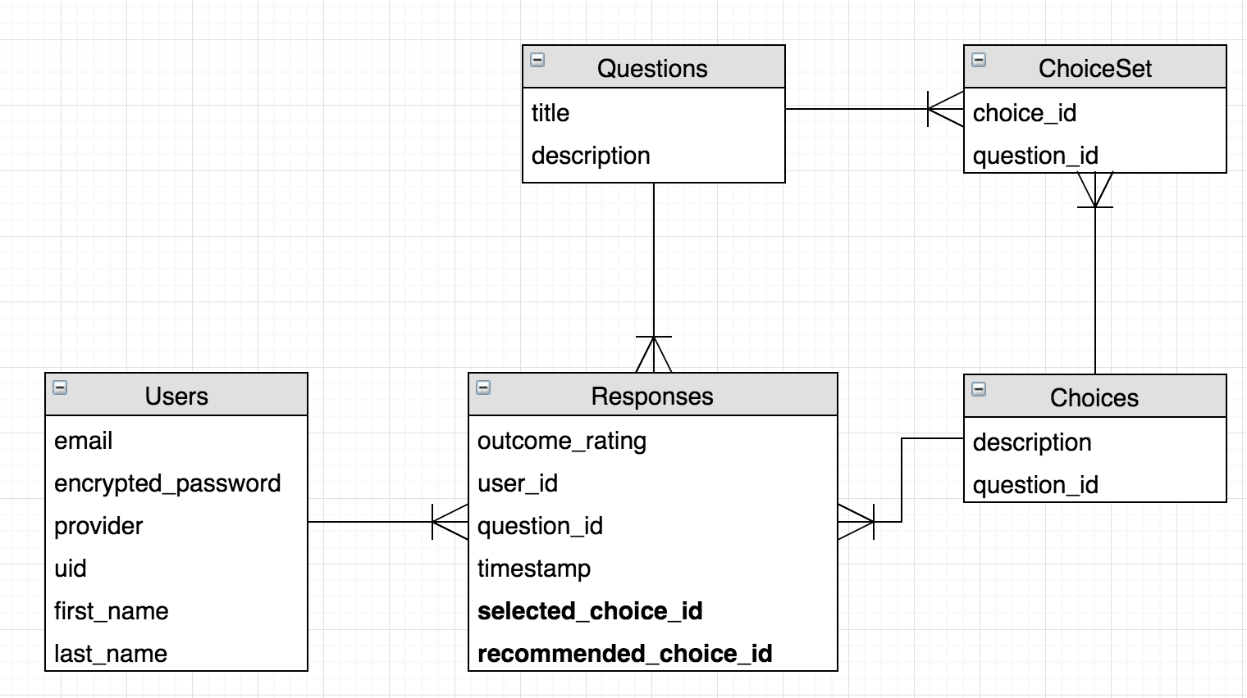
ER Diagrams...will make or break your app
Notes:
Draw a box for each table you plan on having in your database
Inside each box, write the name of the database table, and list each column name you plan on having in the table
Draw lines between the tables that are connected to each other. (I.e, the character table and a table that has a column for character_id are connected

Slide 13
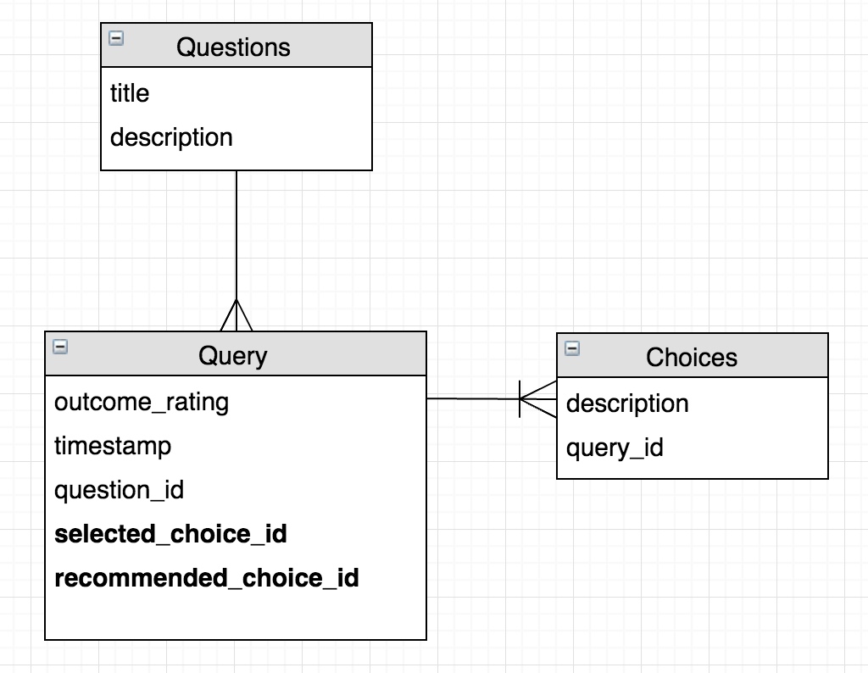
ER Diagrams...will make or break your app
Notes:
Draw a box for each table you plan on having in your database
Inside each box, write the name of the database table, and list each column name you plan on having in the table
Draw lines between the tables that are connected to each other. (I.e, the character table and a table that has a column for character_id are connected

Slide 14
ER Diagrams
Possible tools:
Google Drawings
Draw.io (free and... ok)
Lucidchart (nicer but not free, 30-day free trial)
Whiteboard and Photo, or Pen and Paper (my preferred methods)

Slide 15
User Stories and Acceptance Criteria
As a... <some kind of user of your site>
I want to... <do something with your site>
So that... <some user goal is achieved>

Slide 16
User Stories and Acceptance Criteria
As a user
I want to submit links to my favorite songs
So that I'm able to share my awesome music finds with my friends.
As a user
I want to see a list of favorite songs submitted by my friends
So that I'm able to discover new good music that's been vetted by my friends.
As an admin
I want to delete a song off of the list of favorite songs
So that I'm able remove inappropriate content.
Notes:
User stories don't go into implementation details - **that's what acceptance criteria are for**. This is a list of implementation details that you consider necessary for a feature to be considered complete. Usually, each user story has a set of acceptance criteria to further describe it

Slide 17
User Stories and Acceptance Criteria
As a user
I want to submit links to my favorite songs
So that I'm able to share my awesome music finds with my friends.
[ ] I can visit "/songs/new" and view a form to submit a new song
[ ] I must fill out "Title", "URL", and "Rating" to submit a new song
[ ] I can optionally fill out "Description" when submitting a new song
[ ] "Rating" must be a number between 1 and 5
[ ] If any required fields aren't properly filled out when I try to submit the form, I get a descriptive error message and remain on the page.
[ ] If I submit a successfully filled-out form, I get redirected to "/songs" and can see my new song on the list.

Slide 18
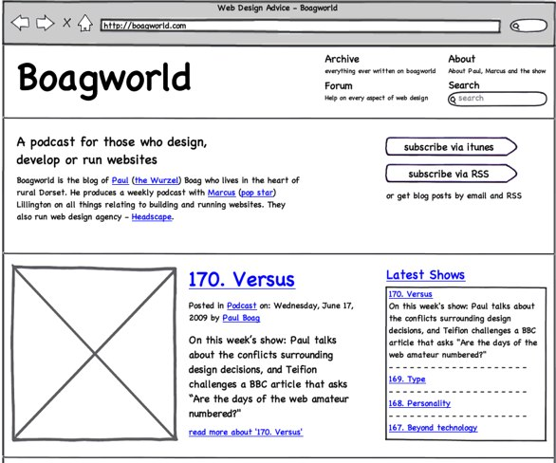
[OPTIONAL] Wireframing

Slide 19
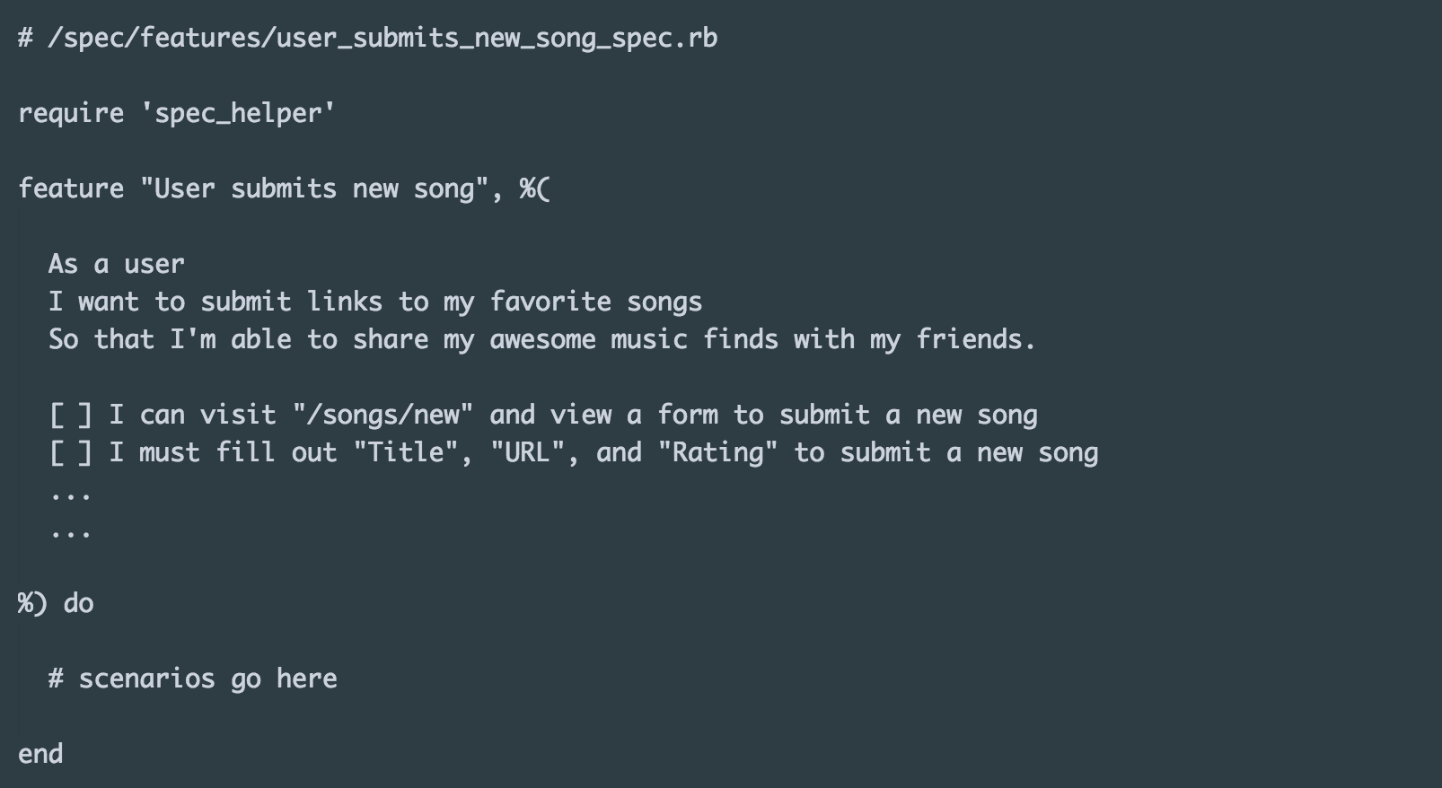
Write ONE Feature Test

Slide 20
TDD Off Into The Sunset!
"Oh, my tests say I don't have that table set up yet. That makes sense, since I don't."
"Let's write some unit tests to test-drive my creation of that model."
*...tdd model via unit tests...*
"Yay, now I have my model, let's see what the next error is in my feature test"
Pick a new user story, and do it again!

Slide 21


Slide 22
Tips
3
Please learn from my mistakes

Slide 23
Start small, and take small steps!
Notes:
Complexity kills

Slide 24

Start small, and take small steps!
Notes:
Complexity kills

Slide 25

Start small, and take small steps!
Notes:
Complexity kills

Slide 26
Start small, and take small steps!
Notes:
Complexity kills.

Slide 27
Some app > No app
A working Grocery List is better than half-built Facebook

Slide 28
Making the most of your time
Prioritize your features - and focus on one at a time
Use the tools available to you - don't reinvent the wheel
Quality over quantity (cohesive UX vs. "landfill of features")
Don't forget to style!

Slide 29
Deploy early and often
Things break in production. Don't wait till the last minute!

Slide 30
Thanks!
Any questions ?
You can find me at
@justinhuynh

